Slide 1
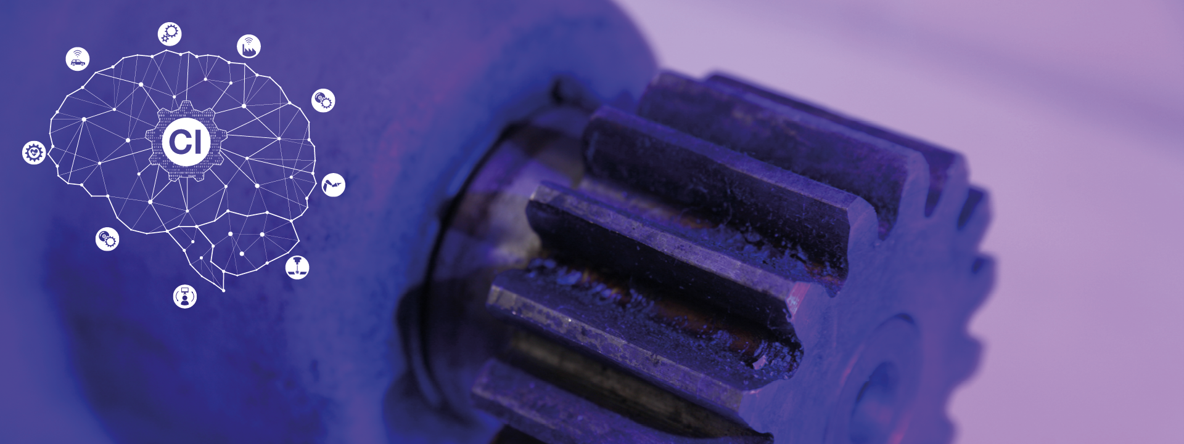
Task A45
Group 2

Slide 2
Team Members and Work Distribution
Abimathi Siva Subramanian 403592 (Member 1)
Anna Garoufali 405801 (Member 2)
Daria Gelbich 405860 (Member 3)
Rohan Krishna Balaji 403596 (Member 4)
Pre-processing
Reading data and Frequency estimation : Members 1, 2,3 ,4
Filters : Members 1,2
Cropping data : Member 1
Rotation : Members 1,3
Segmentation : Members 4,3
Resampling : Members 4,2
Removing malicious sequences : Member 4
Neural Networks
Optimizing parameters : Members 1,2,3,4
Code Unification and Structuring : Members 1,4
Code Comments : Member 1
Presentation slide preparation : Member 2,3,4

Slide 3
Project Description
Data source: Smartphone 3 and sex and age
Sensor signal: Acceleration and Gyroscope Data
Validation: 5 fold subject-wise
Compare the Results obtained based on different anthropometric parameters (sex & age)
Step 1&2: Reading Files and passing them into functions
Read the CSV file to numpy array. This data is passed as parameters into function to perform specific preprocessing tasks (filtering, cropping, rotation, segmentation and resampling).

Slide 4
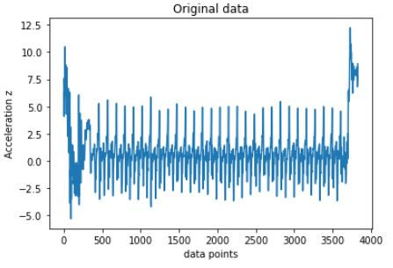
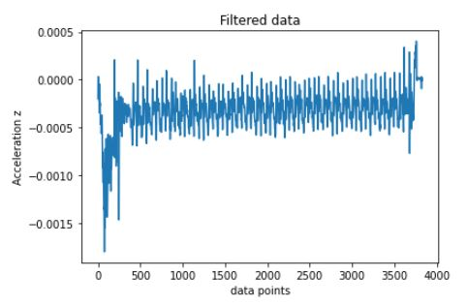
Data Preprocessing
Step 3: Implementation of Filter
Butterworth filter is used to filter the high frequency noise present in the data.

Slide 5
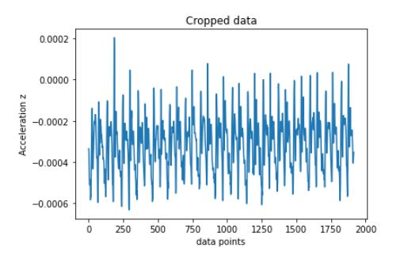
Data Preprocessing
Step 4: Cropping
Elimination of undesirable data, to obtain the starting and ending points of the trail.
Before cropping

Slide 6
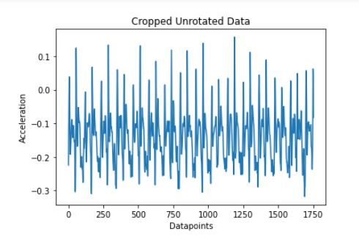
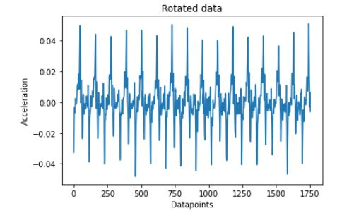
Data Preprocessing
Step 5: Rotation
The scaled data is centered and then the data is rotated such that the acceleration is maximum along one axis

Slide 7
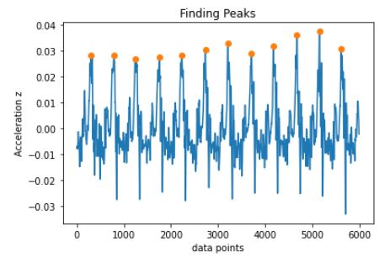
Data Preprocessing
Step 6: Segmentation
The peaks in the data are identified so that the whole motion sequence is segmented into different steps.

Slide 8
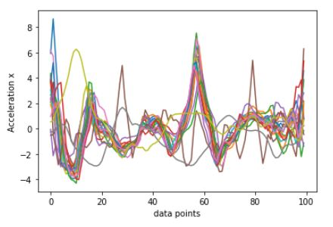
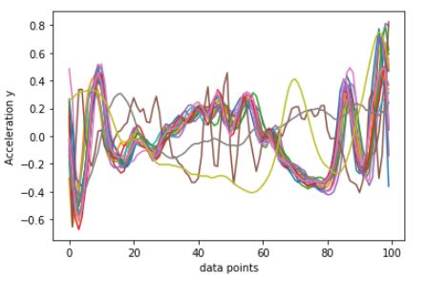
Data Preprocessing
Step 7: Resampling
The different samples have different number of data points, so resample them such that all the samples have equal number of data points.

Slide 9
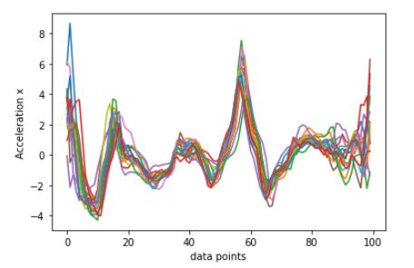
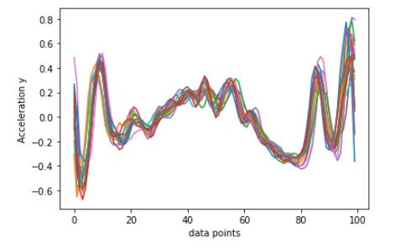
Data Preprocessing
Step 8: Elimination of Malicious Sequences
The mean and standard deviation of all the data at each point is calculated. If the points in the sample lie outside the threshold (mean + or - std) then they are removed as outliers.

Slide 10

Neural Networks (1/2)
Represents
Nodes of activation
functions
Represents weights
Input Layer
Output Layer
Sigmoid activation functions
Hidden Layers

Slide 11
Results
Age |  | Sex
Accuracy ( in %) | Loss | Accuracy (in %) | Loss
56.14 | 0.683 | 51.42 | 0.698
57.23 | 0.674 | 56.12 | 0.686
51.42 | 0.698 | 51.74 | 0.705
56.45 | 0.673 | 57.23 | 0.683
63.24 | 0.632 | 63.25 | 0.676
Average Loss Based on Sex : 0.682
Average Accuracy Based on Sex: 56.89 %
Average Loss Based on Age : 0.692
Average Accuracy Based on Age: 55.97 %
Note: Accuracy represents the fraction (percentage) of correct classification of predicted data to label data (i.e., Normal or Impaired)

Slide 12
Conclusion
Observations and Conclusion:
Quality of Data and Pre-processing has significant influence on performance of Neural Network
Influence of Anthropometric data is less significant in classification
Structure of Neural network, activation functions and other parameters had very limited influence on results
We can predict if the subject walking has Normal or Impaired gait using motion data with a probability of just over 55% irrespective of his age or sex.

Slide 13
.
Thank You
.

